Slide 1
TAXPAYERS SYSTEM
Developer George Chimwaza

Slide 2
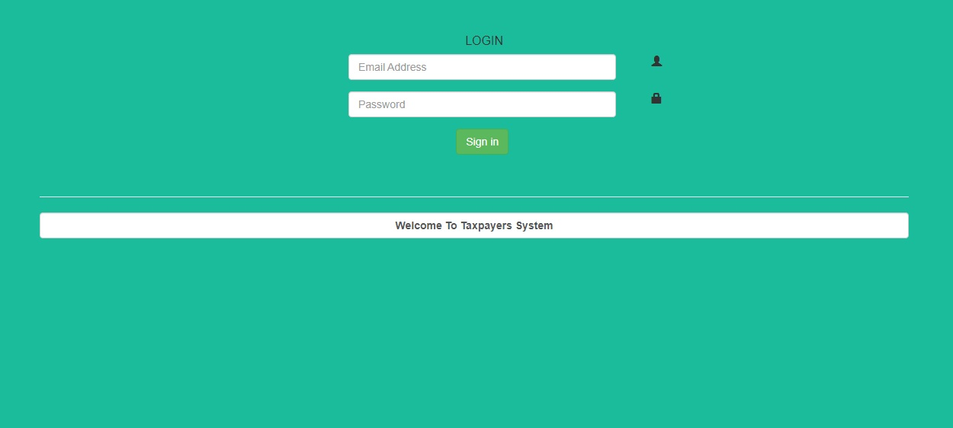
LOGIN FORM
Email and Password credentials are entered on this form to get access to the system. Only authorized username can have access.

Slide 3
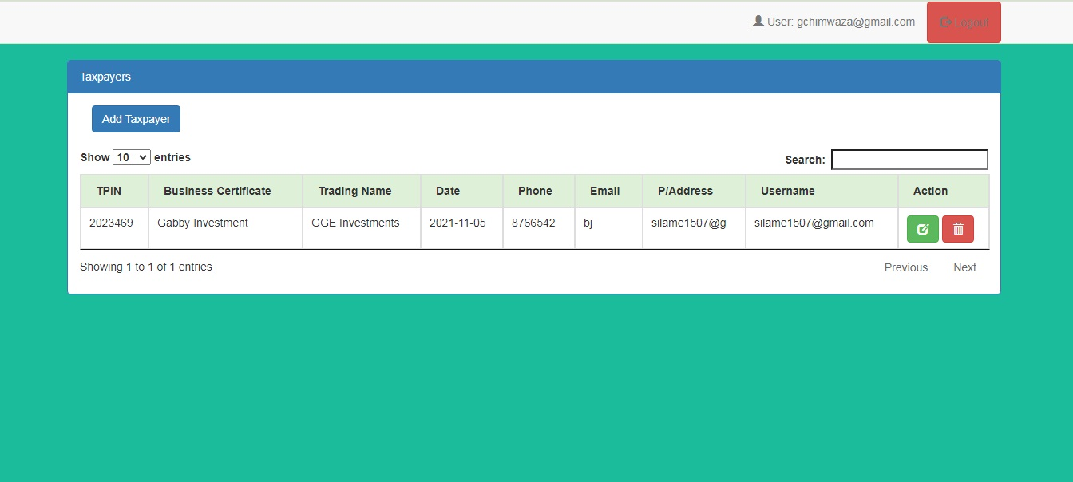
VIEW LIST
This page appears after user authentication and shows logged in user on top.
It displays all the taxpayers entered in the system.
Submenu with options buttons like Add Taxpayer, Edit, Delete and Logout.

Slide 4
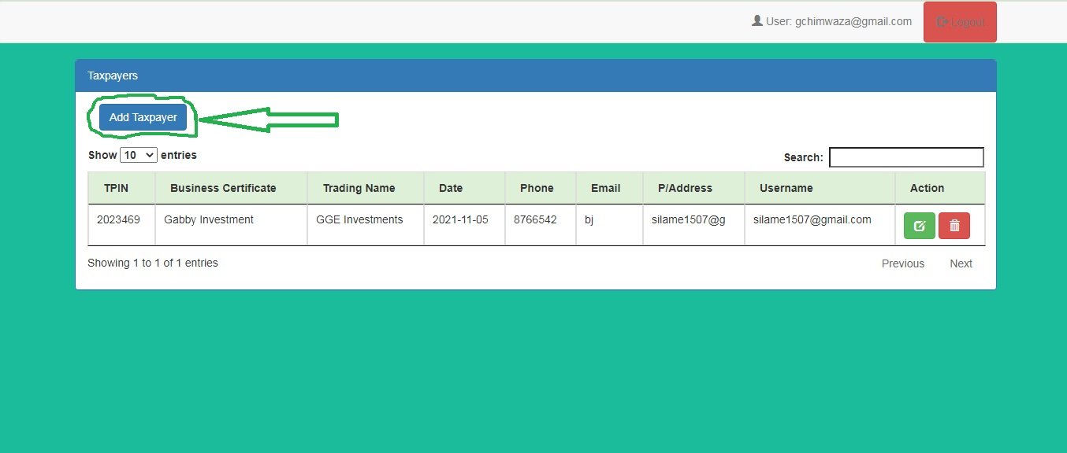
Add Taxpayer Button
Leads to Add Taxpayer Form.

Slide 5
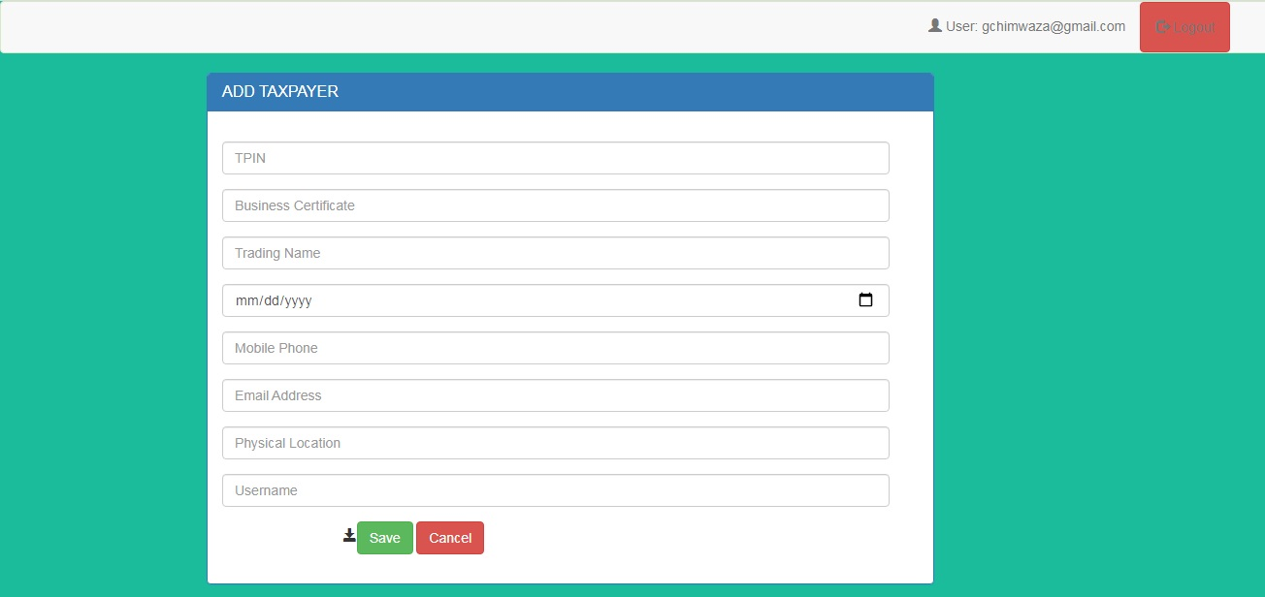
Add Taxpayer Form
Taxpayer Data Entry.
Consists of submit and cancel button.
Submit button is used to save data after filling the form.
Cancel button is used to exit the form to View list form.

Slide 6
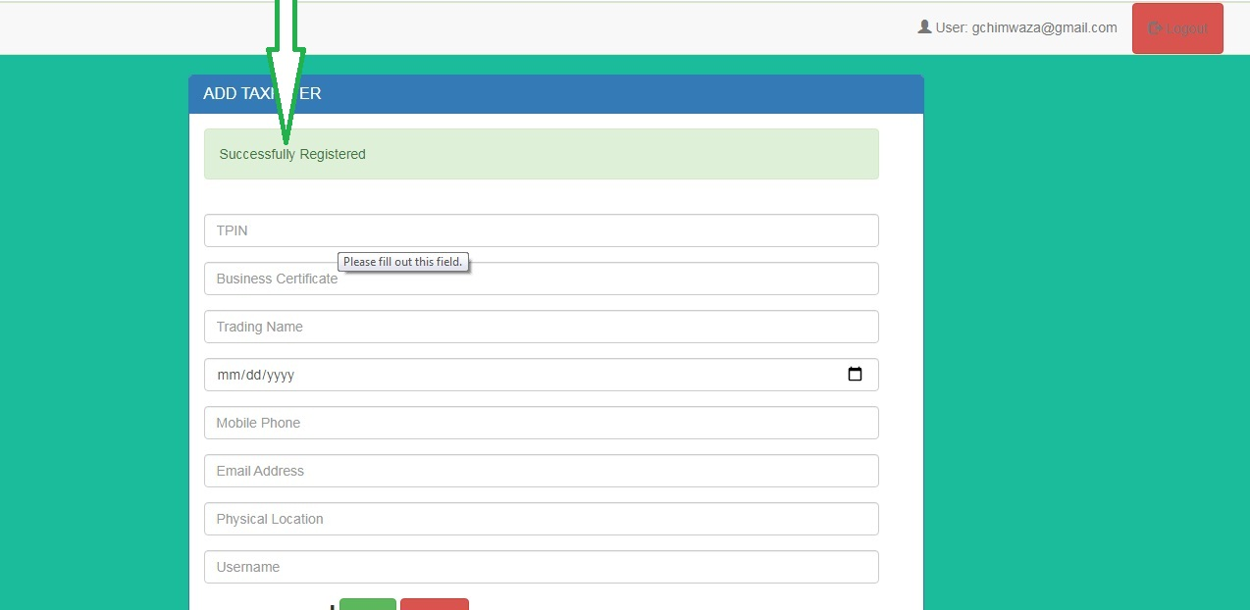
Add Taxpayer Message
Displayed message after saving data.

Slide 7
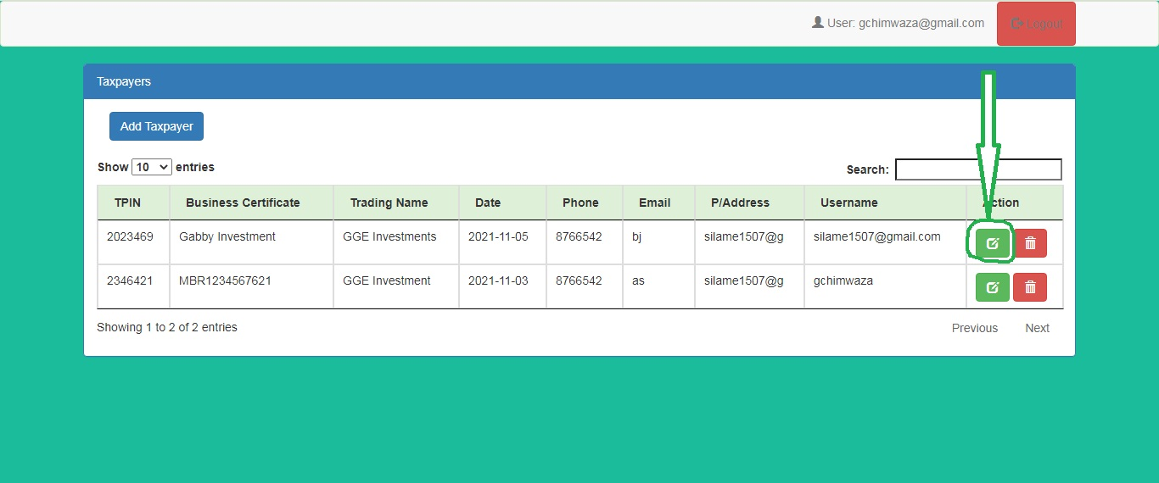
Edit Taxpayer Button
Leads to Edit Taxpayer form.

Slide 8
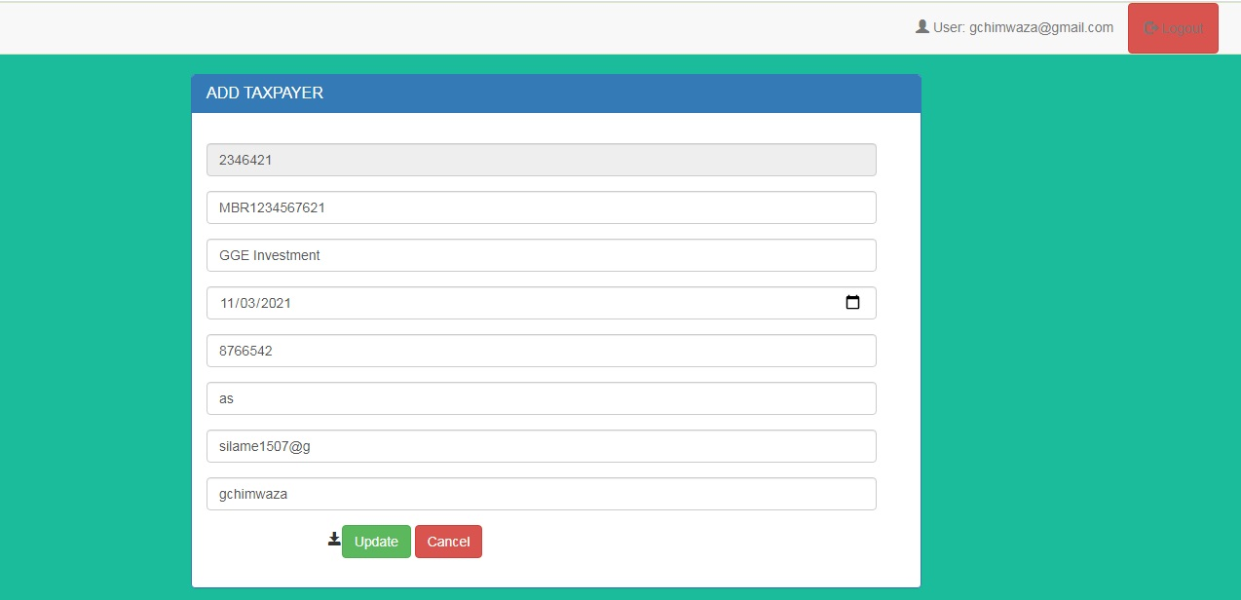
Edit Taxpayer Form
Opened Taxpayer details are editable.
Consists of Update and Cancel.
Update is used to save edited details on the form.
Cancel is used to exit the form to View list taxpayers.

Slide 9
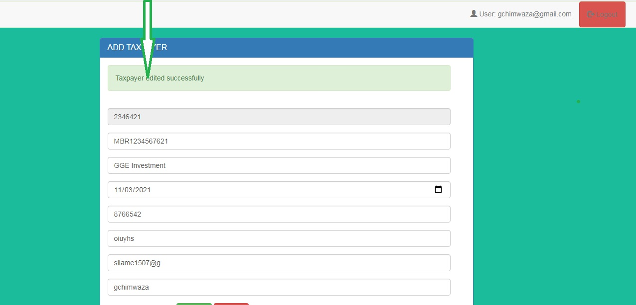
Edit Taxpayer Form
Displayed message after updating.

Slide 10
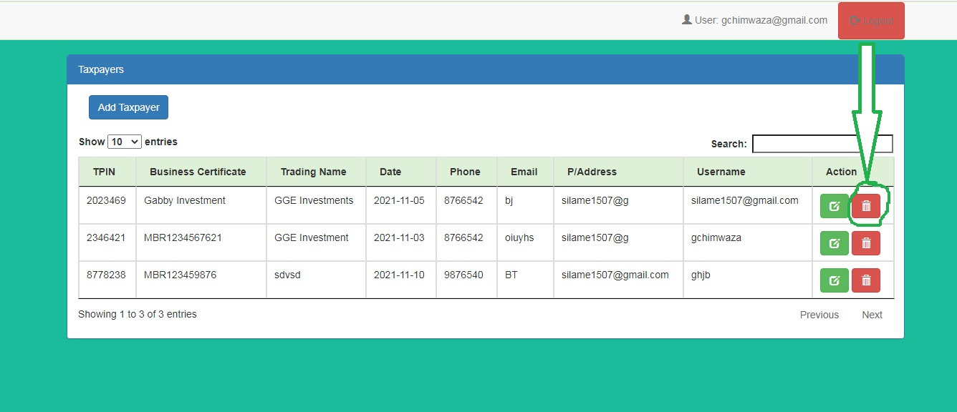
Delete Taxpayer Button
Used to delete taxpayer details.
Record is deleted depending on select delete button using TPIN field.

Slide 11
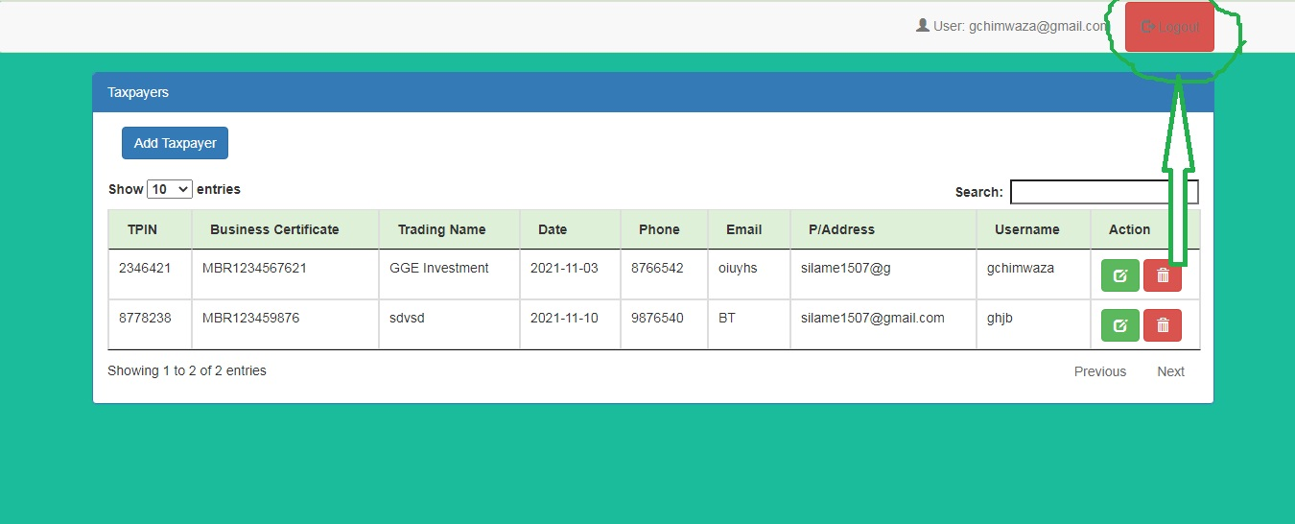
Logout Button
Used to exit the system to login page.

Slide 12
THE END

